Slide 1


An Investigation of Particulate Matter 2.5 in the District of Columbia During the COVID-19 Pandemic
A Capstone Project in partial fulfillment of the course DATA - 606
Niko Darby, Snehika Pandey, and Tamrat Workineh
Advisor : Dr. Ozgur Ozturk
November /2021

Slide 2
Introduction
Particulate Matter 2.5 is a small particle such as dirt, soot, dust, or smoke that is about 2.5 ug/m3 LC (EPA, 2021). Particulate Matter 2.5 has been linked to COVID-19 and cancer:
Higher COVID-19 transmissions (Shafinaz et al., 2021; Comunian et al. 2020)
COVID-19 RNA has been found on PM2.5 fragments (Shafinaz et al., 2021; Comunian et al. 2020)
PM2.5 is also linked to the oncogenesis of various cancers (Shafinaz et al., 2021; Comunian et al. 2020)

Slide 3
Why PM2.5 ?
The team, concerned with the increasing number of deaths of the target residents due to the Covid – 19, initiated this project to investigate if there is association between PM2.5 and covid disease.

Slide 4
What Study Show:
“ Outdoor and indoor air pollution cause respiratory and other diseases and is an important source of morbidity and mortality. ” WHO
“ PM_{2.5}, PM₁₀ and NO₂, in COVID-19 spread and lethality ”
Gaps:
Conducted research who first investigated research methods not all include confounding factors.
There are no research conducted specifically for Washington DC metro areas .

Slide 5
Goal::
Investigate Particulate Matter 2.5, with the confounding factors of PM10, CO, SO2, and NO2 concentrations in the District of Columbia and its impact on the COVID-19 pandemic.
Predict the trends of PM2.5 over various spans of
time proceeding the pandemic.
During the COVID-19 pandemic, the rates of PM2.5 could have fluctuated due to the quarantine that occurred in 2020. Constructing a predictive model will aid in scrutinizing the trends of PM2.5 overtime (2021-2022 and onward)
to examine if PM2.5 influences the increase or decrease of COVID-19 transmission rates - while also taking COVID-19 mortalities into consideration.

Slide 6

Project Description:
The datasets were collected from the US –Environmental Protection Agency (US- EPA) and COVID-19 data was procured from Johns Hopkins University (JHU).
Initially the dataset collected contained 879, 531 Columns and 29 Rows:
EPA Dataset Size: > 30,000 Data Points
JHU Dataset Size: > 800,000 data points
EPA Condensed Size: >70 Data Rows
JHU Condensed Size: > 149 Data Rows

Slide 7
State Code
Address
Longitude
Latitude
Parameter Occurrence Code
Datum
County Code
Site Num
Longitude
Parameter Name
Sample Duration
Pollutant Standard
Date Local
Units_ of_ Measure
Event Type
Observation Count
Observation Percent
Date of Last Change
AQI
Method Code
Method Name
Arithmetic Mean
1st Max Value
1st Max Hour
Local Site Name
State_ Name
County _Name
City Name

Slide 8
EDA: Data Cleaning and Manipulation
The collected dataset had many attributes some of which were irrelevant to data mining, or some are redundant., the study used attribute Subset Selection Method to reduces the volume of data by eliminating the redundant and irrelevant attribute.
Workable Datasets:
DeathIncrease: Monthly Death Rate of the target due to Covid
Ozone_ Contain: Monthly Ozone Concentration of Ozone
NO2_Contn: Monthly Ozone Concentration of Nitrogen Oxide
CO_ Concn: Monthly Ozone Concentration of Carbon Monoxide
Temp_ Avg: Monthly Ozone Concentration of Temperature
SO2 _Content: Monthly Ozone Concentration of Sulfur Dioxide
PM2.5_Contn Monthly Ozone Concentration of PM2.5

Slide 9
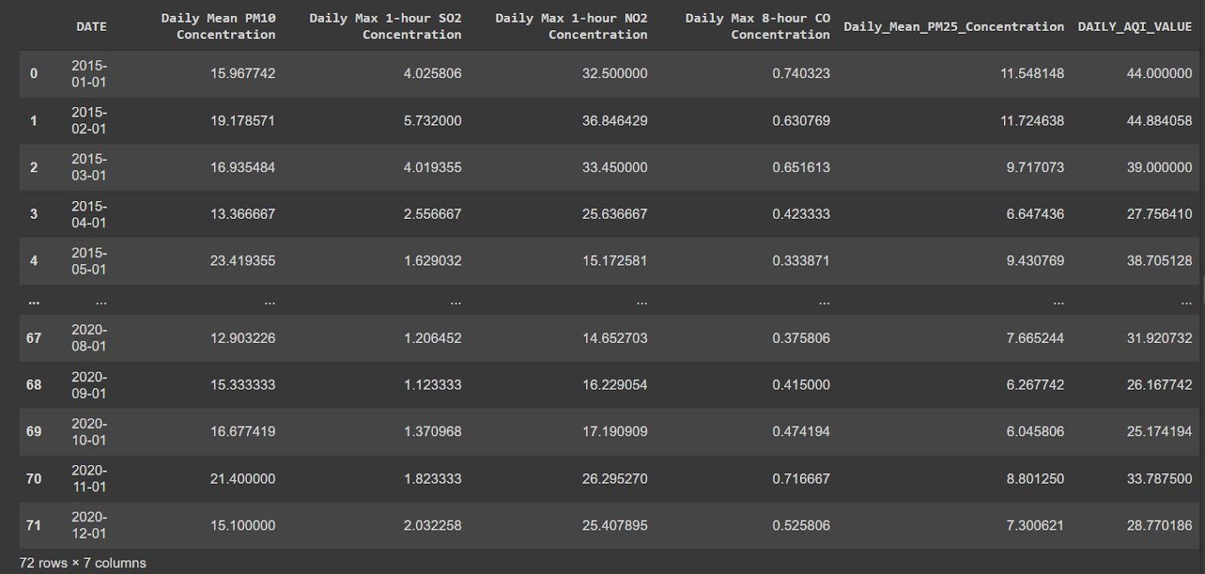

Slide 10
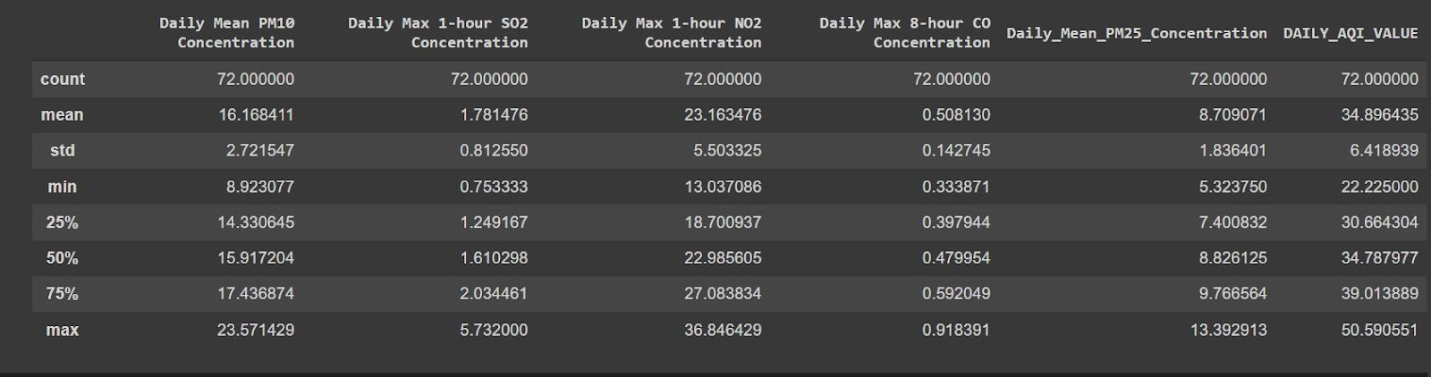

Slide 11
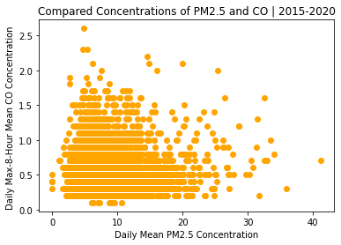
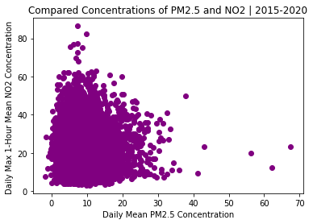
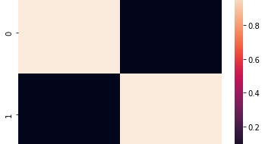
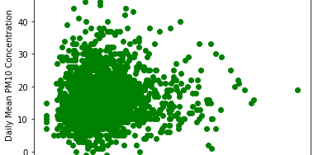
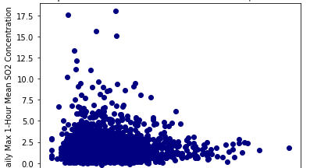
Partial View of Workable datasets
EDA: Patterns and Trends I

Slide 12
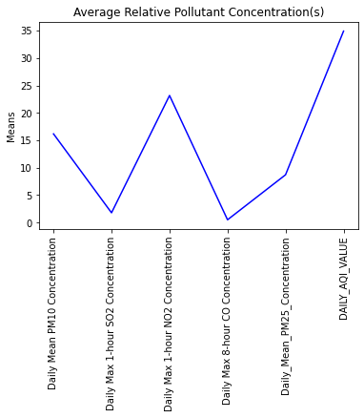
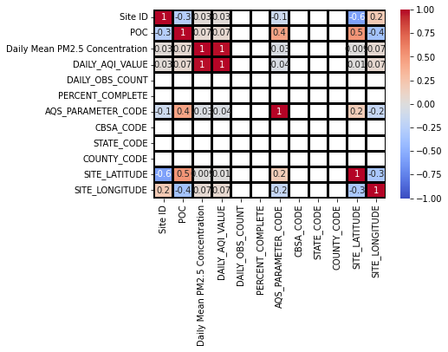
EDA: Patterns and Trends II

Slide 13
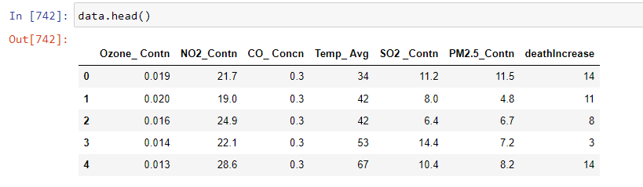

Slide 14
Method:
To evaluate the Environmental Pollutants PM2.5, CO, NO2, and O3 on the Incidence and Mortality of Covid 19 in DMV, the study use historical data obtained from Environmental Protection Agency and National Climate data Center. Data Visualization, Machine Learning, Prediction and Linear Regression model and correlation analysis of PM2.5, CO, NO2, and O3 data will be made to determine their impact on the Pandemic.

Slide 15
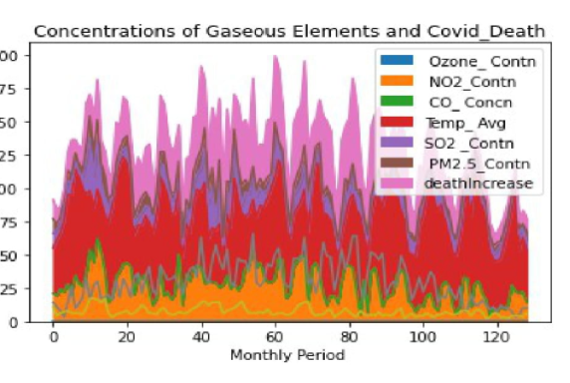
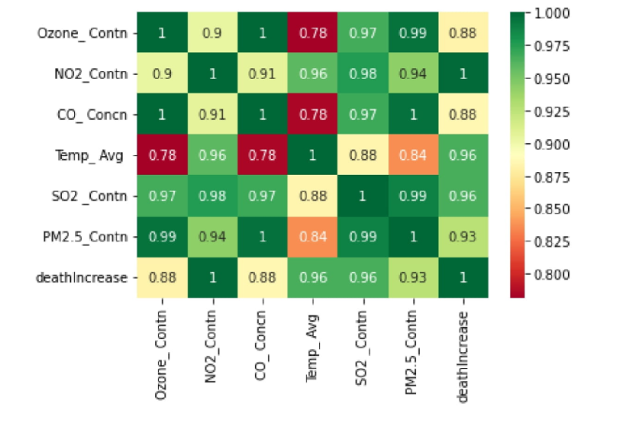
EDA: Patterns and Trends III
Graphs showing the correlation of concentration of feature values of Ozone,N02,Temp ,SO2 ,PM2.5 and the target (Death Increase due to Covid pandemic. The green color refers to high correlation as opposed to the red color which shows less correlation.

Slide 16
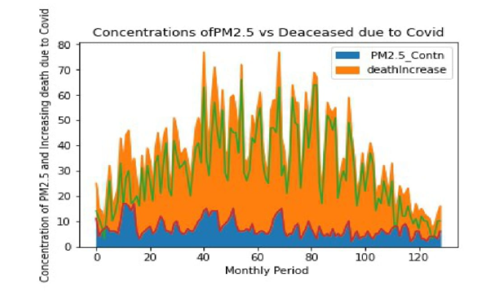

Slide 17
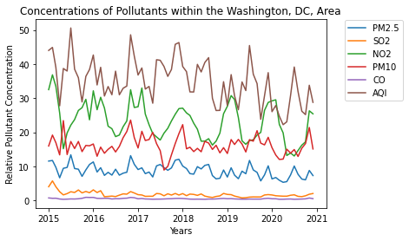

Slide 18
Regression Analysis Model

Slide 19
Why Regression Analysis Model ?
The study team attempted to use different models , but Regression analysis model provides detailed insight and a reliable method of identifying which variables have impact . Furthermore , performing a regression allows you to confidently determine which factors matter most, which factors can be ignored, and how these factors influence each other.

Slide 20
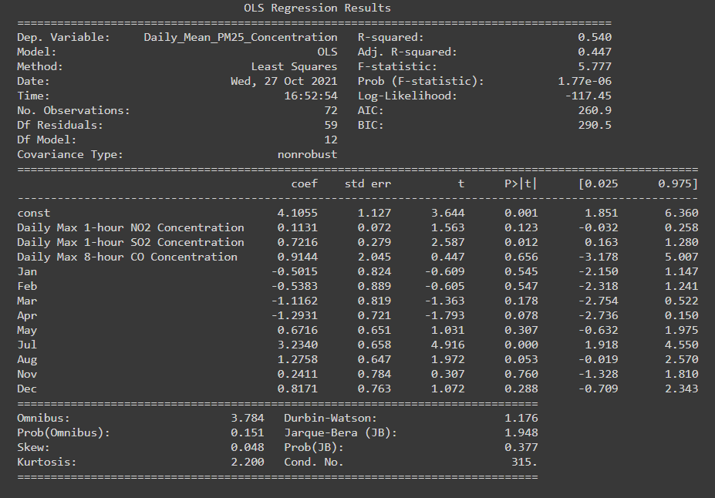
Evaluating the Regression Model

Slide 21
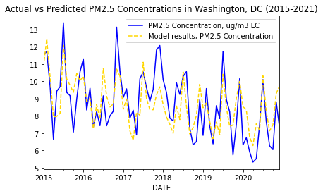
Visualizing the regression analysis result

Slide 22
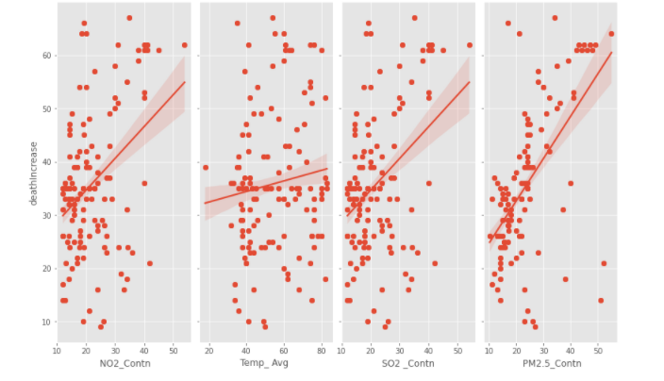
Graphs showing the correlation of concentration of feature values of Ozone,N02,Temp ,SO2 ,PM2.5 and the target (Death Increase due to Covid pandemic. From the graph it can be deduced that Death Increase highly correlates to N02,SO2 ,PM2.5 .

Slide 23
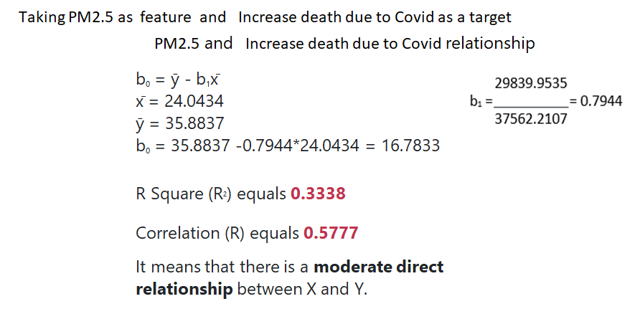

Slide 24
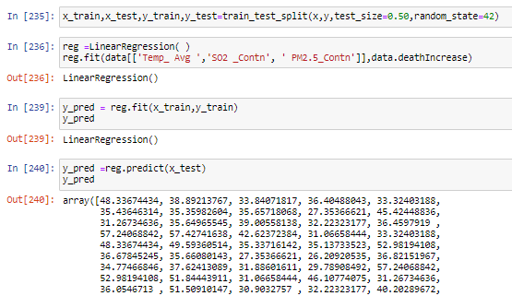

Slide 25
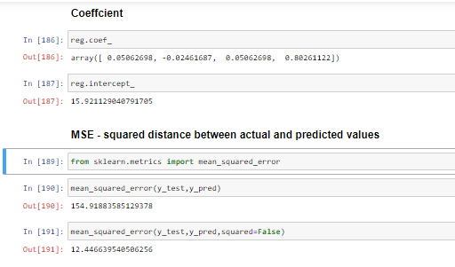
MSE ,R Square, Adjusted R Square, RMSE, MAE

Slide 26
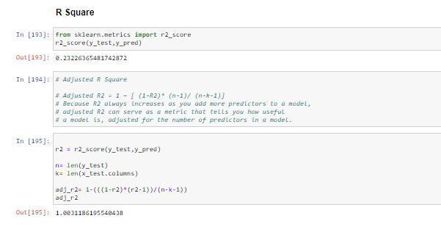

Slide 27
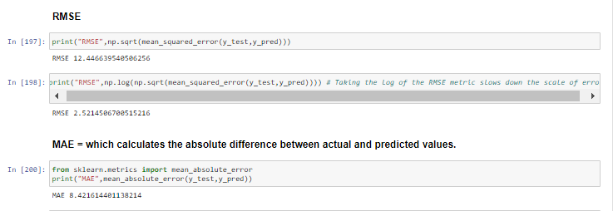

Slide 28
The regression equation for the linear model takes the following form: y = b 0 + b 1 x 1. In the regression equation, y is the response variable, b 0 is the constant or intercept, b 1 is the estimated coefficient for the linear term (also known as the slope of the line), and x 1 is the value of the term.
Taking PM2.5 as feature and Increase death due to Covid as a target
PM2.5 and Increase death due to Covid relationship
b₀ = ȳ - b₁x̄ x̄ = 24.0434 ȳ = 35.8837 b₀ = 35.8837 -0.7944*24.0434 = 16.7833
R Square (R²) equals 1.0
Correlation (R) equals 0.8777
It means that there is a very good direct relationship between the predictor and the predict

Slide 29
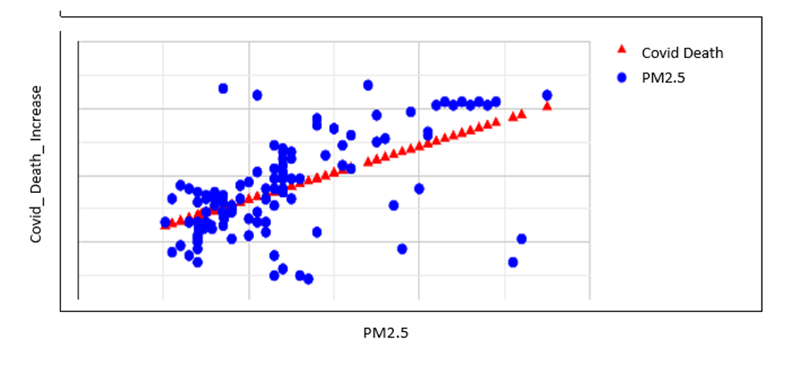
Regression Analysis: PM2.5 and COVID-19 Deaths

Slide 30
Next Steps
Add more features as per the professor’s good advice and interpreted the results
Continue and complete the Django Full-Stack Development integration (HTML,
CSS, JavaScript, Python)
Integrate a user input system
Port the completed website to the World Wide Web

Slide 31
References:
Effect of environmental pollutants PM2.5, CO, No2, and O3 on the incidence and mortality of SARS-CoV-2 infection in five regions of the USA
(PDF) Effect of environmental pollutants PM2.5, CO, No2, and O3 on the incidence and mortality of SARS-CoV-2 infection in five regions of the USA (researchgate.net)
Evaluating the Contribution of PM2.5 Precursor Gases and Re-entrained Road Emissions to Mobile Source PM2.5 Particulate Matter Emissions (epa.gov)
Washington Air Quality Index (AQI) and Washington, D.C. Air Pollution | AirVisual (iqair.com)
Effects of SO2 and NOx emission reductions on PM2.5 mass concentrations in the southeastern United States - PubMed (nih.gov)
Order History | Climate Data Online (CDO) | National Climatic Data Center (NCDC) (noaa.gov)
Effect of Environmental Pollutants PM2.5, CO, NO2, and O3 on the Incidence and Mortality of SARS-CoV-2 Infection in Five Regions of the USA
World Health Organization, Air pollution (who.int)

